Slide 1


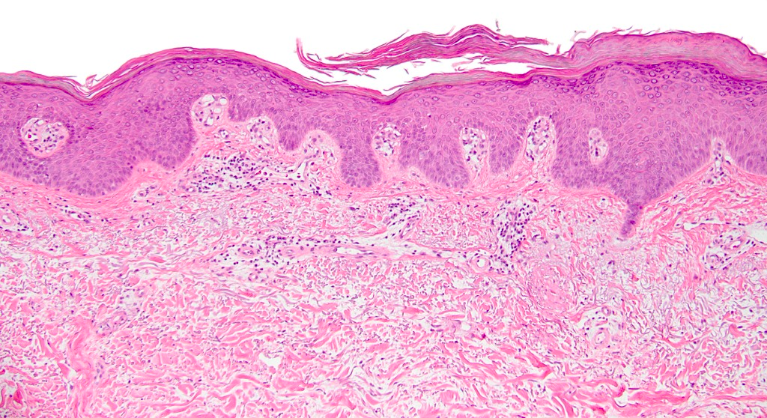
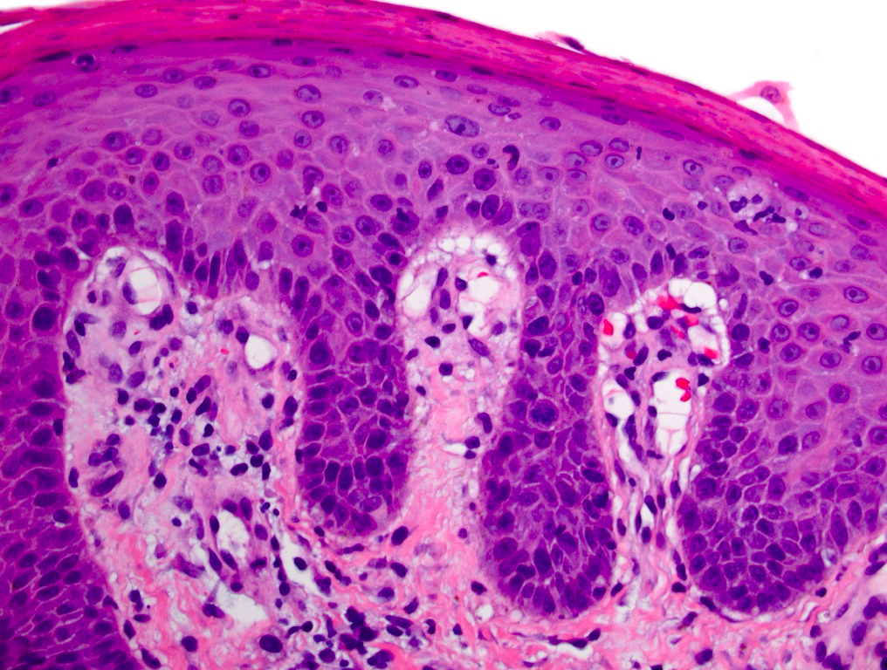
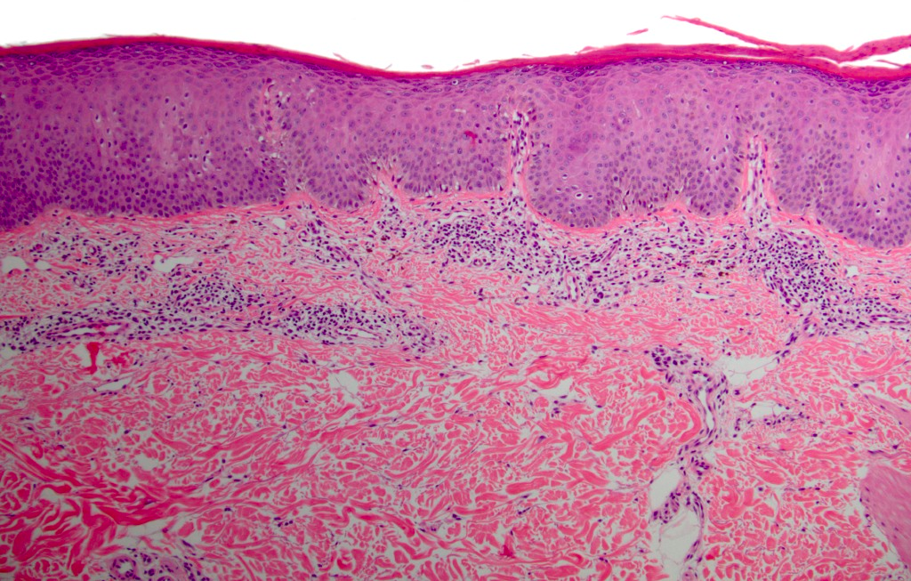
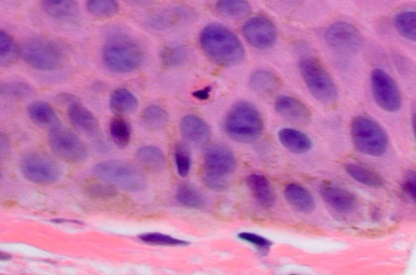
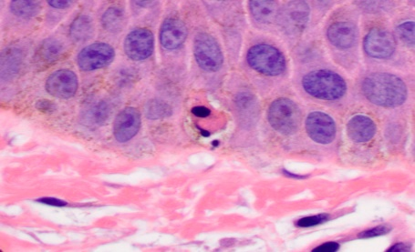
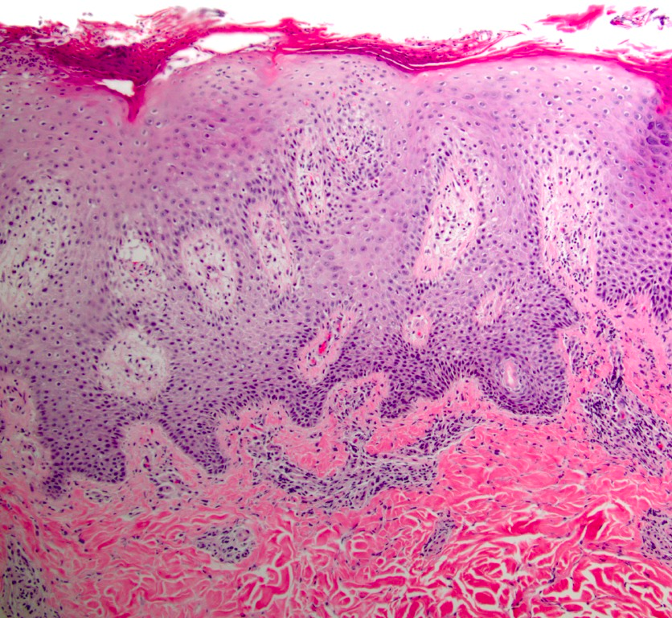
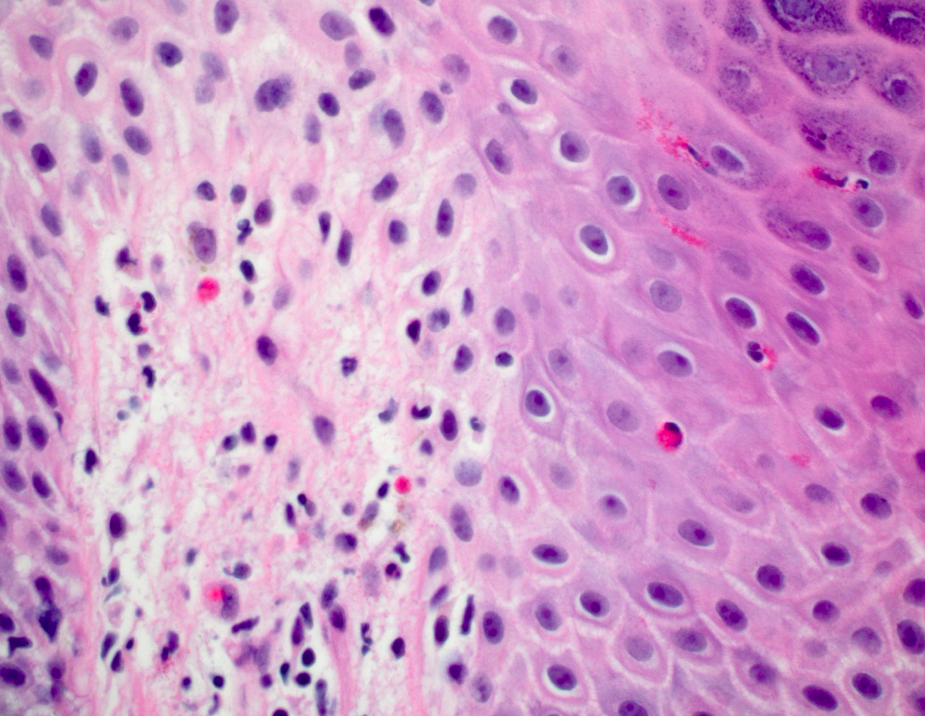
An expanded histopathologic spectrum of psoriasis:
review of 51 clinically confirmed cases
Thinh Chau, Kory K. Parsi, Toru Ogawa, Maija Kiuru, Thomas Konia, Maxwell A. Fung
University of California Davis, Departments of Dermatology and Pathology, Sacramento, CA
Introduction
Findings
Typical histopathologic features included regular acanthosis, hypogranulosis, dermal papillae capillary ectasia, club-shaped rete ridges, suprapapillary plate thinning, Munro microabscess, and spongiform pustule of Kogoj. Atypical histopathologic features included irregular acanthosis, compact orthokeratosis, hypergranulosis, lichenoid and vacuolar interface alterations, stratum spinosum and stratum basale necrotic keratinocytes, spongiosis, eosinophilic spongiosis, dermal neutrophils, eosinophils, and plasma cells, and papillary dermal fibrosis.
Minors and pregnant women were excluded from the study. Approval was obtained from the University of California Davis Institutional Review Board.
Introduction: Psoriasis is a common, chronic inflammatory skin disease affecting 2-3% of the US population. Although the classical histopathologic features of psoriasis have been well-documented for decades, the clinical manifestations of psoriasis are distinctive enough that the diagnosis is generally made on clinical features alone, both in routine practice and for clinical trials. Mirroring their clinical counterparts, the histopathologic features considered classical for psoriasis comprise a well-documented spectrum but have remained largely unchanged and unvalidated. Furthermore , there are no criteria for establishing a diagnosis of psoriasis in patients lacking classic clinical and/or histologic findings. Likewise, the range of non-classical findings that may be seen in psoriasis has not been well-documented. Consequently, when non-classical or atypical histopathologic findings are encountered, there may be uncertainty as to whether such findings are acceptable for psoriasis or indicative of an alternate diagnosis. Thus, there is a need to update the histopathologic features encompassed by psoriasis.
Table 1. Patient Demographics and Clinical Characteristics
Figure 1. Irregular Acanthosis, Hypergranulosis, and Compact Orthokeratosis
Table 1A. Patient Demographics (n = 46, %)
Age in years (median, range) | 53, 16-91
Male (n, %) | 20, 43%
Female (n, %) | 26, 57%
Figure 1. Psoriasis vulgaris. Biopsy from the right forearm of a 37 year old woman shows irregular acanthosis, interspersed hypogranulosis and hypergranulosis, and compact orthokeratosis (arrows).
Table 1B. Clinical Characteristic (n = 46, %)
Classic Morphology | 42, 91%
Classic Distribution | 39, 84%
Family History | 12, 26%
Nail Pitting | 10, 22%
Psoriasis type
Vulgaris | 30, 65%
Inverse | 5, 11%
Guttate | 3, 7%
Palmoplantar | 2, 4%
Erythrodermic | 6, 13%
Figure 2. Spongiotic Microvesicle and Junctional Vacuolar Alteration
Figure 2. Psoriasis vulgaris. Biopsy from the left hand of a 75 year old woman shows a non-neutrophilic, non-eosinophilic spongiotic microvesicle and junctional vacuolar alteration (arrows).
Conclusion
Table 2. Typical and Atypical Histopathologic Features
Conclusion: Our study highlights atypical features such as irregular acanthosis, vacuolar interface changes, hypergranulosis, necrotic keratinocytes, neutrophilic spongiosis, dermal neutrophils and eosinophils that may occur in clinically confirmed psoriasis. Our study reveals that the histopathologic spectrum of psoriasis is broader than currently documented in the literature and may diminish the ability of dermatopathologists to rule out psoriasis based solely on histology.
Table 2A. Typical Features (n=51, %)
Hypogranulosis | 49, 96%
Club-shaped rete ridges | 49, 96%
Dermal papillae capillary ectasia | 46 ,90%
Munro microabscess | 40, 78%
Suprapapillary plate thinning | 32, 63%
Spongiform pustule of Kogoj | 27, 53%
Regular acanthosis | 7, 14%
Methods
Figure 3. Lichenoid Interface Alteration and Necrotic Keratinocytes
Methods: Clinical diagnostic criteria for psoriasis were developed, informally validated, and applied to a consecutive series of patients whose biopsies received a microscopic diagnosis of psoriasis or most likely psoriasis between 2010 and 2014, inclusive. Inclusion criteria comprised at least two of the following as documented in electronic medical records: 1. classic morphology, 2. classic distribution, 3. nail pitting, and 4. family history of psoriasis, requiring either classic morphology or distribution. Classic morphology was defined as well-circumscribed, sharply-demarcated red papules or plaques with silver-white, micaceous scale. Classic distribution was defined as involvement of the scalp, elbows, knees, or gluteal region for psoriasis vulgaris; axillary, inguinal, or intergluteal folds for inverse psoriasis; and palmoplantar for pustular psoriasis.
Figure 3. Psoriasis vulgaris. Biopsy from the back of a 50 year old man shows lichenoid interface alteration (arrows) and necrotic keratinocytes in the spinous and basal layers (insets).
Table 2B. Atypical Features (n=51, %)
Irregular acanthosis | 43, 84%
Junctional vacuolar alteration | 39, 76%
Spongiosis | 39, 76%
Dermal neutrophils | 35, 69%
Hypergranulosis | 33, 65%
Stratum spinosum necrotic keratinocytes | 31, 61%
Neutrophilic spongiosis | 31, 61%
Figure 4. Eosinophilic Spongiosis and Dermal Eosinophils
Acknowledgements
Dermal eosinophils | 25, 49%
Compact orthokeratosis | 19, 37%
Stratum basale nectrotic keratinocytes | 18, 35%
Papillary dermal fibrosis | 18, 35%
Lichenoid interface | 13, 25%
Dermal plasma cells | 8, 16%
Eosinophilic spongiosis | 4, 8%
Figures 4. Psoriasis vulgaris. Biopsy from the right upper back of a 37 year old man shows eosinophilic spongiosis and dermal eosinophils (arrows).
The following individuals provided helpful comments for our clinical diagnostic criteria: Christine Carroll (Woodland, CA), Steve Feldman (Winston-Salem, NC), John Koo (San Francisco, CA), Marc Silverstein (Sacramento, CA), Emil Tanghetti (Sacramento, CA).

